Slide 1
Customer Churn Analysis & Retention Strategy in Telecom Industry Internship Project – Team B
Presented By: Tharshika Deepika Anugravathanan

Slide 2
Problem Statement
The telecom industry faces intense competition and a high rate of customer churn. Losing customers not only reduces revenue but also increases marketing and acquisition costs. This project aims to:
Identify Key Churn Drivers : Pinpointing the root causes behind customer attrition.
Segment Customers by Risk : Categorizing customers based on their likelihood of churning.
Propose Actionable Strategies : Developing targeted plans to improve customer retention.

Slide 3
Dataset & Analytical Toolkit
Dataset:
Source: Kaggle – Telco Customer Churn Dataset
Records: ~7,000 customers
Features: Demographics, service usage, contract details, billing, churn status
Tools Used:
Microsoft Excel – Churn analysis , Pivot tables and interactive dashboards
SQL – Aggregation & segmentation
Power BI – Interactive dashboards

Slide 4
Overall Churn Rate
Our analysis reveals a significant churn rate within the telecom customer base. A staggering 26.58% of customers discontinued their services during the period under review. This means over one-fourth of the customer base was lost, highlighting an urgent need for effective retention strategies.

Slide 5
Churn by Internet Service Type
Internet service type plays a crucial role in customer retention. Our findings indicate a stark difference in churn rates across various internet services:
Fiber Optic: At 41.89%, fiber optic customers exhibit the highest churn rate.
DSL: With a 19.00% churn rate, DSL customers show more stability.
No Internet: Surprisingly low churn at 7.43% for customers without internet service.
The data strongly suggests that fiber optic service, despite its perceived benefits, is a significant churn driver. This demands immediate attention to service quality, reliability, and customer expectations for fiber optic users.

Slide 6
Impact of Contract Type on Churn
Contract duration significantly influences customer retention, demonstrating that long-term commitments foster loyalty.
42.7%
Month-to-month
Highest churn risk, customers can easily switch providers.
11.28%
One-year contract
Substantially lower churn, indicating increased commitment.
2.85%
Two-year contract
Lowest churn, highlighting the power of long-term retention.
These figures underscore the importance of incentivizing longer contract terms. Customers on two-year contracts are nearly 15 times less likely to churn compared to month-to-month customers.

Slide 7
Key Insights from Churn Analysis
Contract Risk :
Month-to-month contracts are consistently the riskiest segments, driving the highest churn rates.
Service Impact :
Fiber optic customers exhibit an alarmingly high churn rate, suggesting service quality or expectation gaps.
Retention Power :
Annual and biennial contracts are crucial for retaining customers, showcasing significant loyalty.
Payment Influence :
Certain payment methods correlate with higher drop-off rates, indicating payment process friction.

Slide 8
Customer Segmentation for Targeted Action
To effectively manage churn, we've segmented customers into distinct groups based on their behavior and risk profile.
Loyal Customers: Tenure > 24 months, low churn probability. These are your most valuable assets.
At-Risk Customers: Characterized by high monthly charges (> ₹70) and short tenure (< 6 months). This segment requires immediate intervention.
New Customers: Tenure < 2 months. Their churn probability varies and effective onboarding is critical.

Slide 9
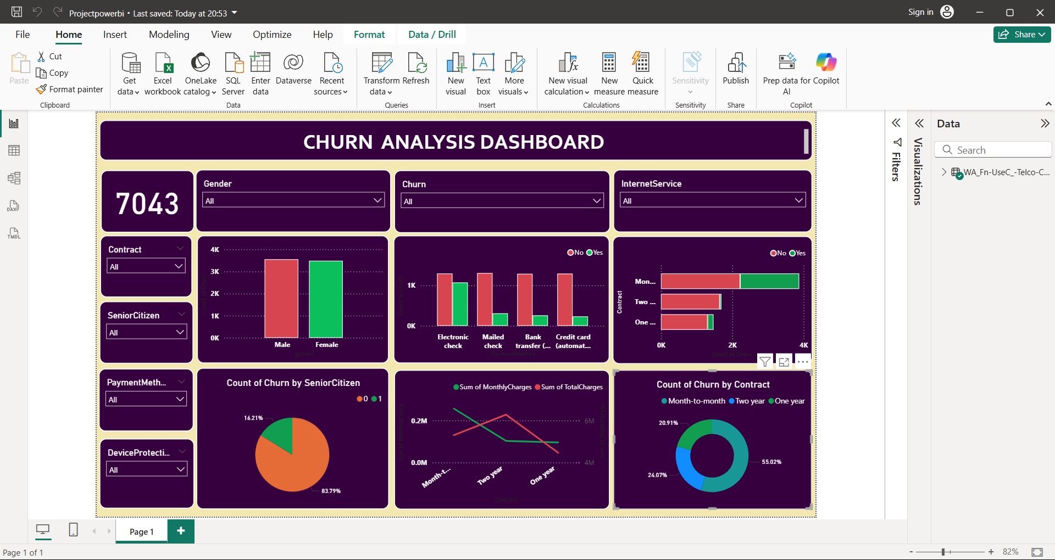
Power BI Dashboard: Visualizing Churn Trends
Our interactive Power BI dashboard provides a dynamic view of churn data, enabling deeper exploration and rapid insight generation. Here are key snapshots:

Slide 10
Actionable Recommendations for Retention
1.Improve Fiber Optic Service
Address pain points (speed, reliability, support) for high-churn fiber users.
2.Optimize Payment Methods
Encourage adoption of reliable and convient payment options
3.Promote Long term Contract
Offer incentives for annual plans to lock-in customer loyalty
4.Customer On-Boarding Programs
Create onboarding with check-ins, offers, and service usage guidance.

Slide 11
CONCLUSION
Our analysis reveals clear churn patterns that can be addressed through proactive retention strategies.
By implementing these strategies, telecom providers can proactively combat churn, enhance customer lifetime value, and drive sustainable growth.

